Slide 1
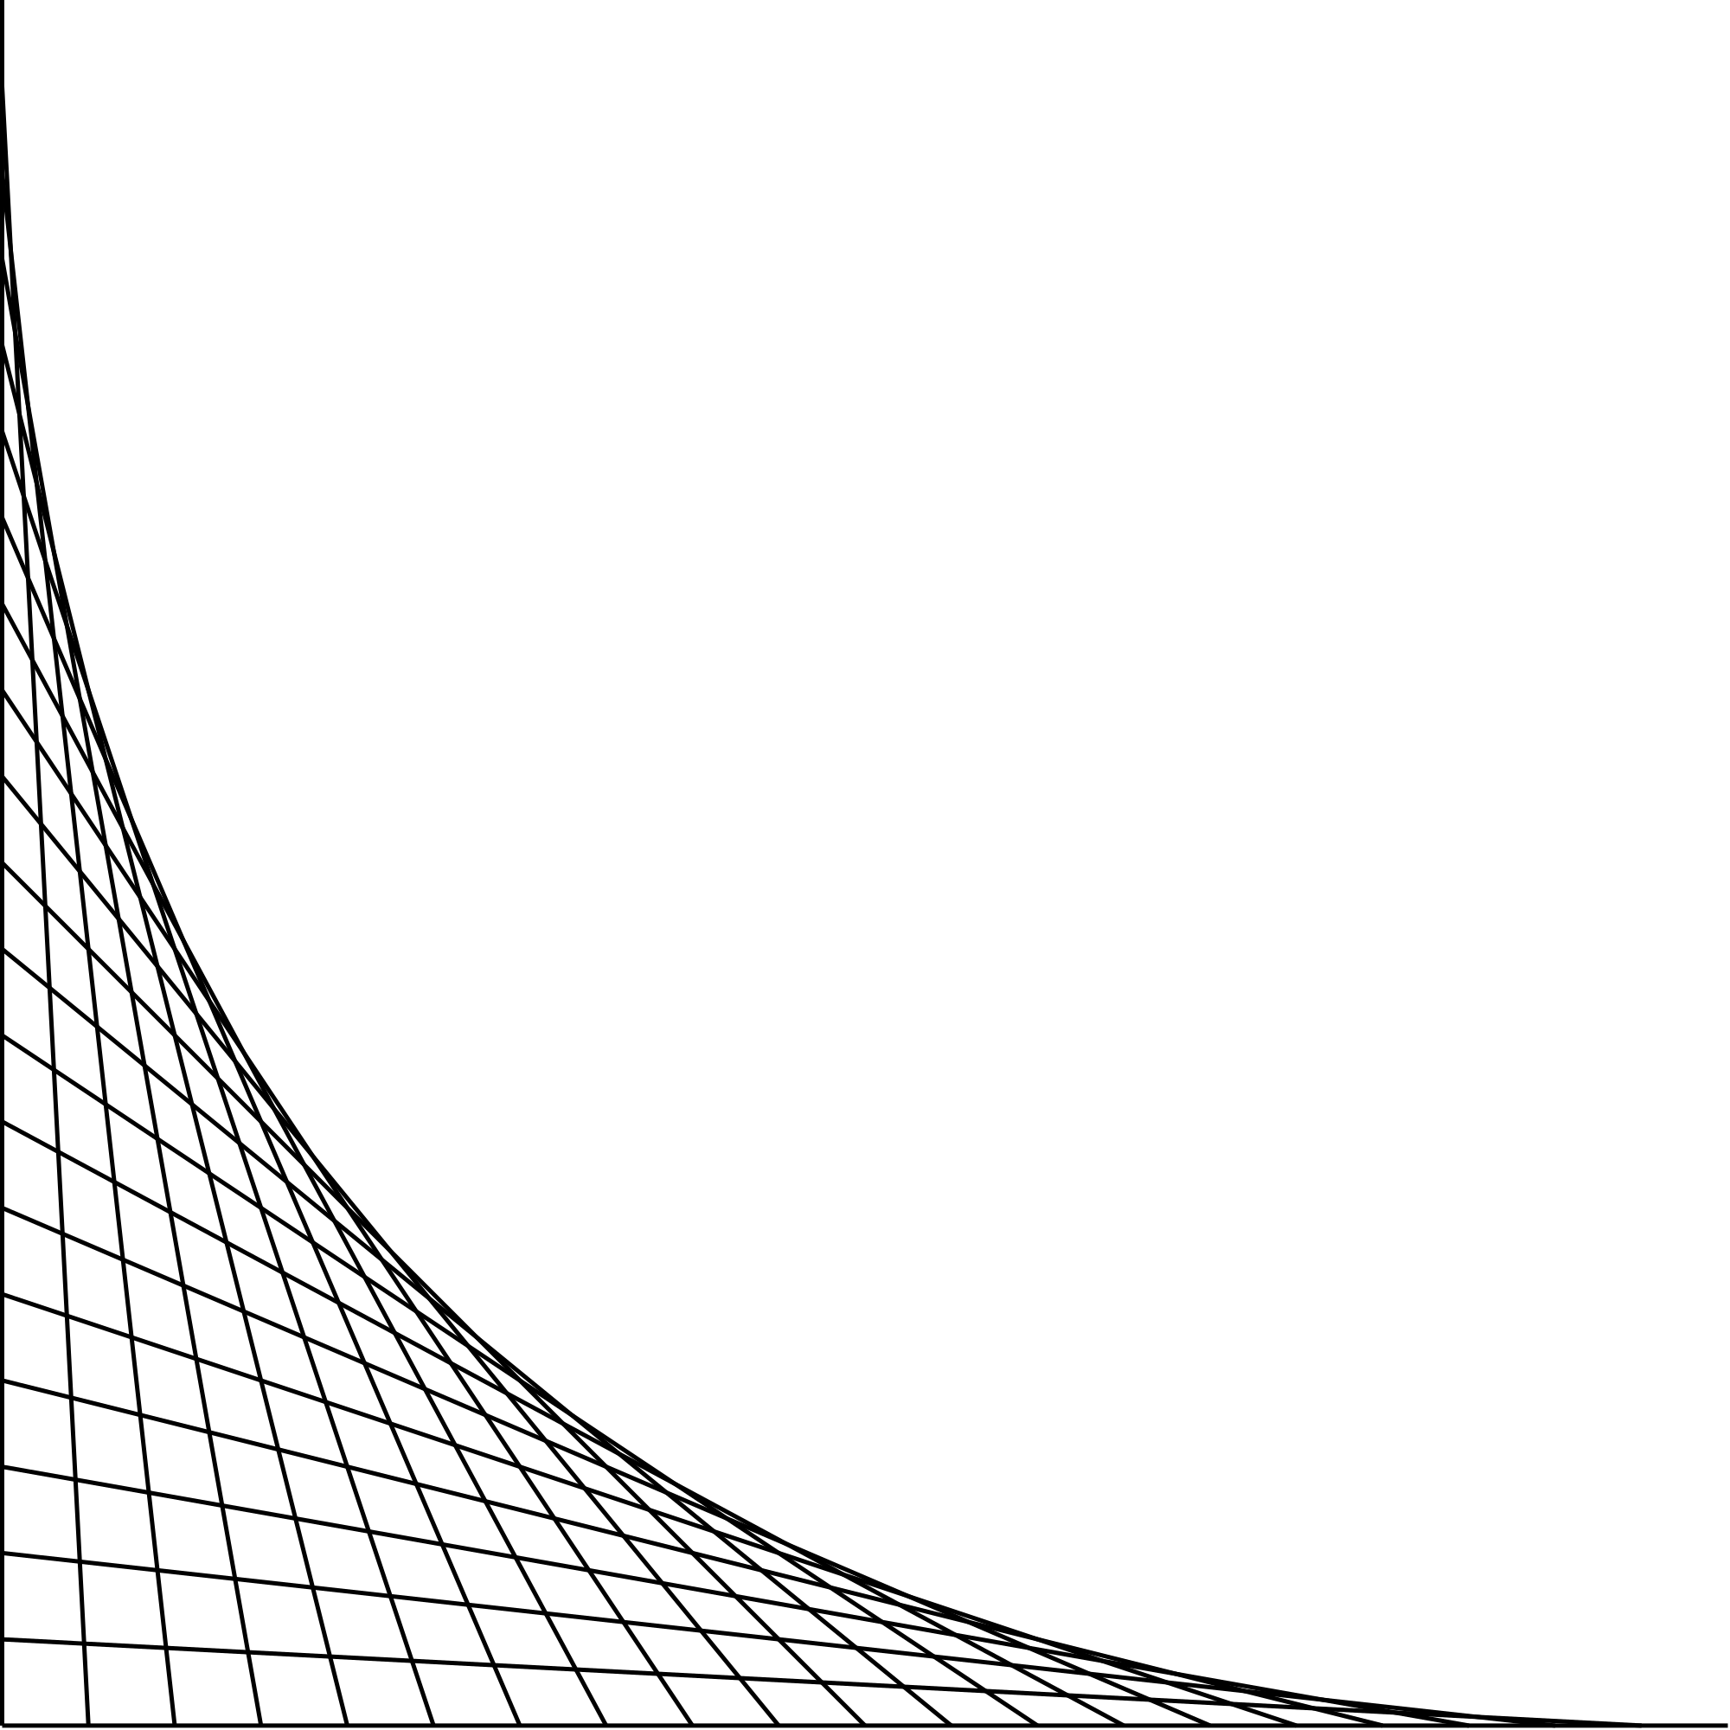












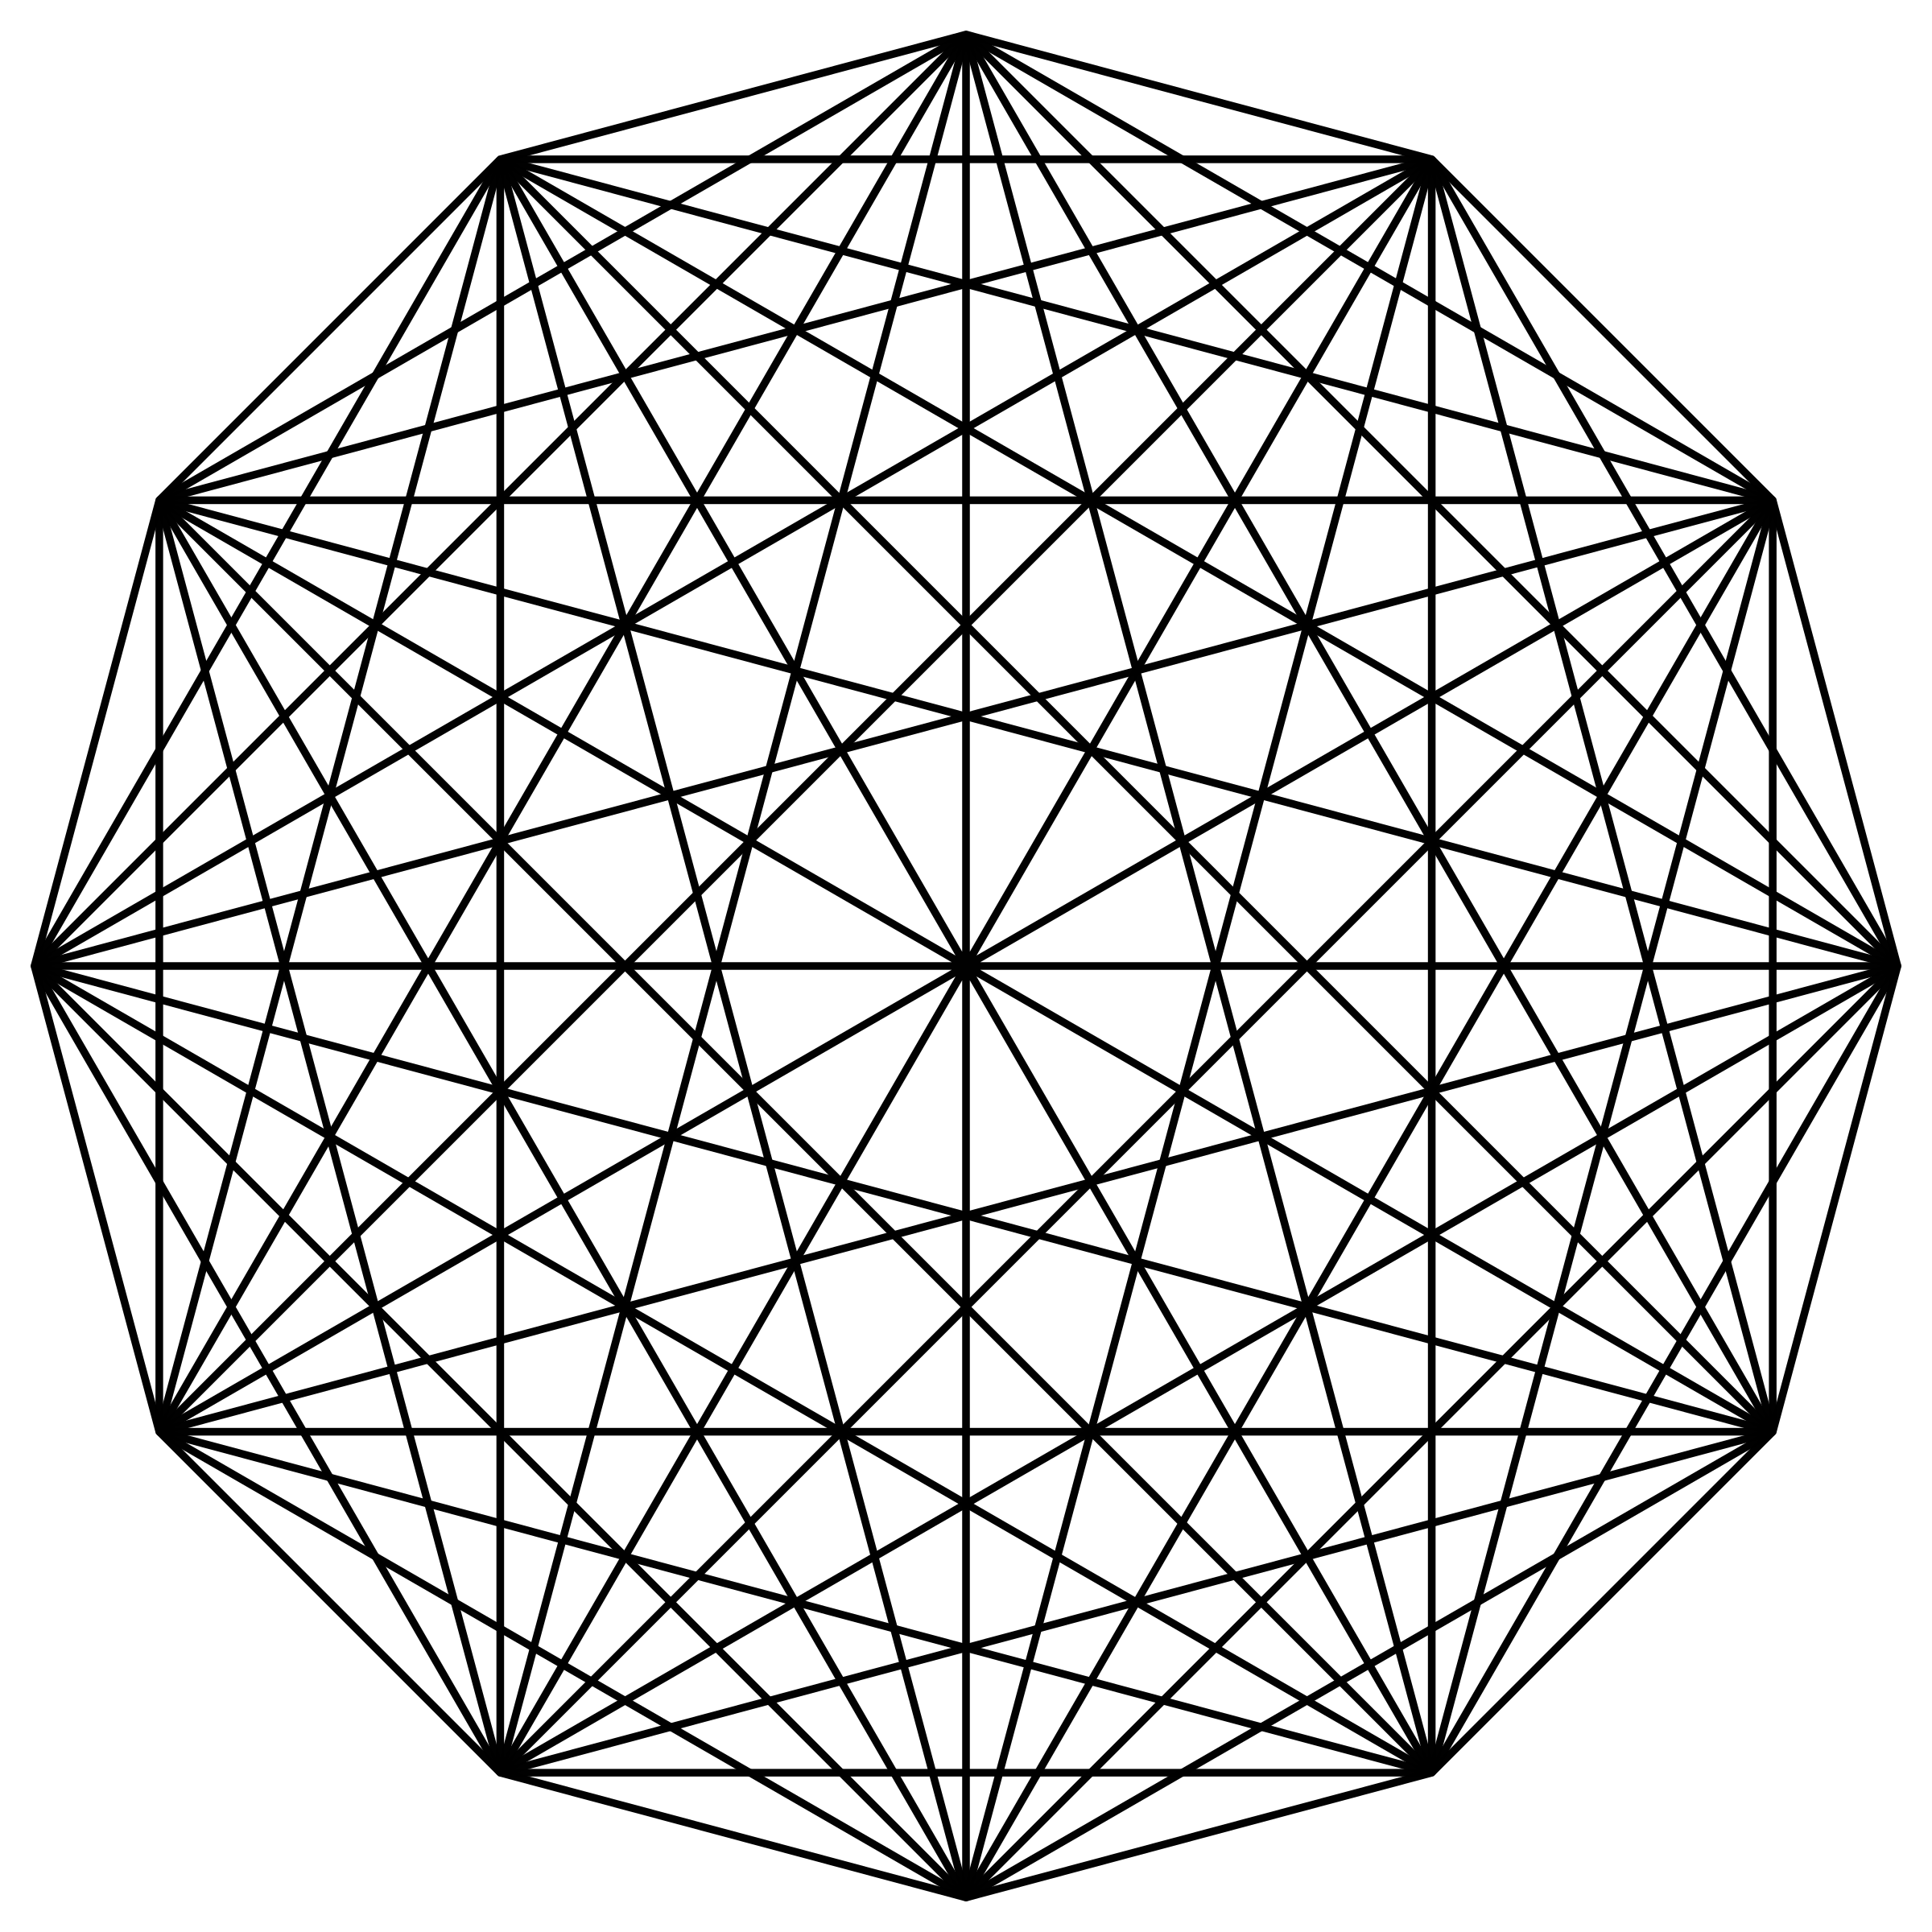
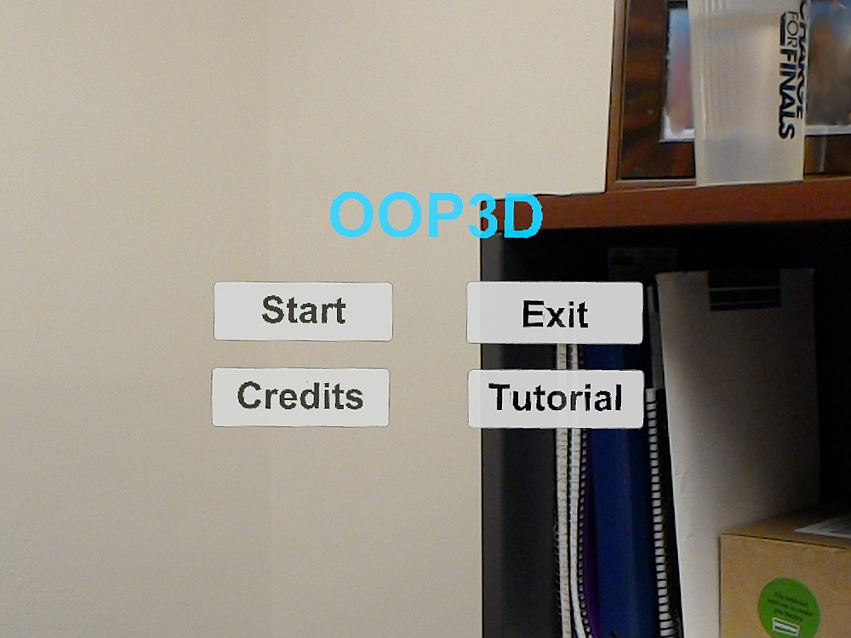
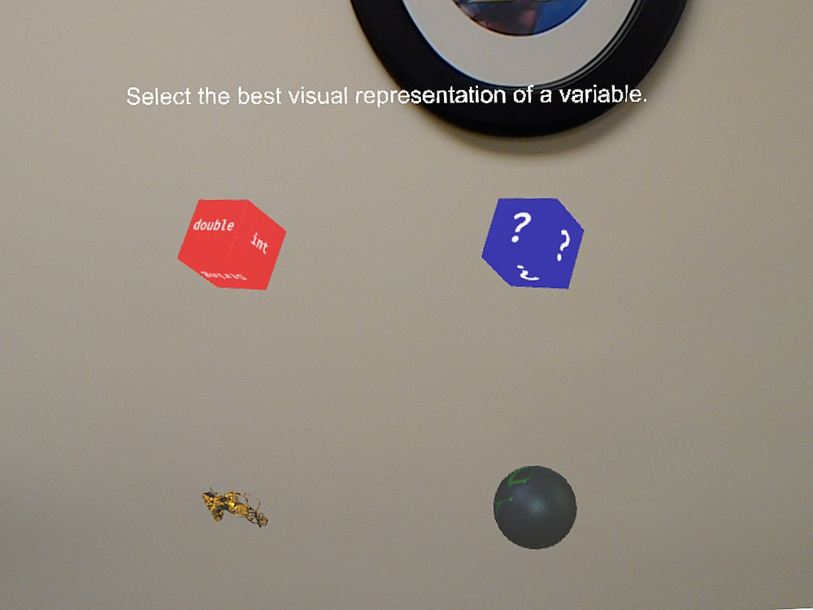
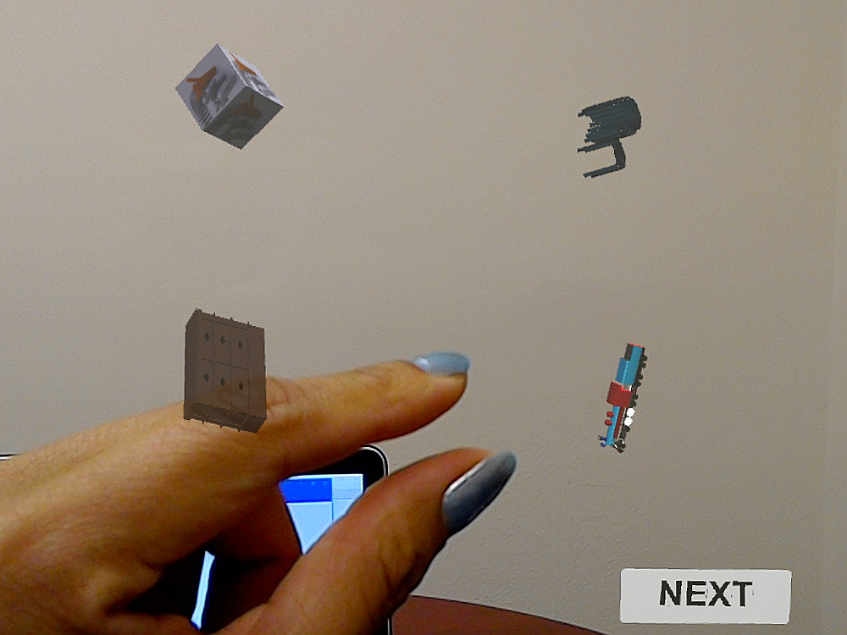
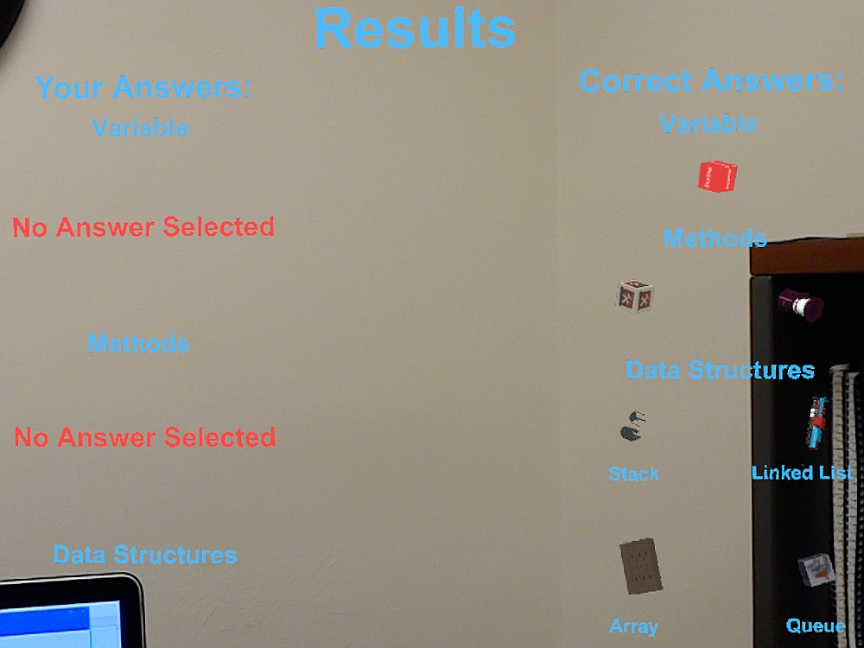
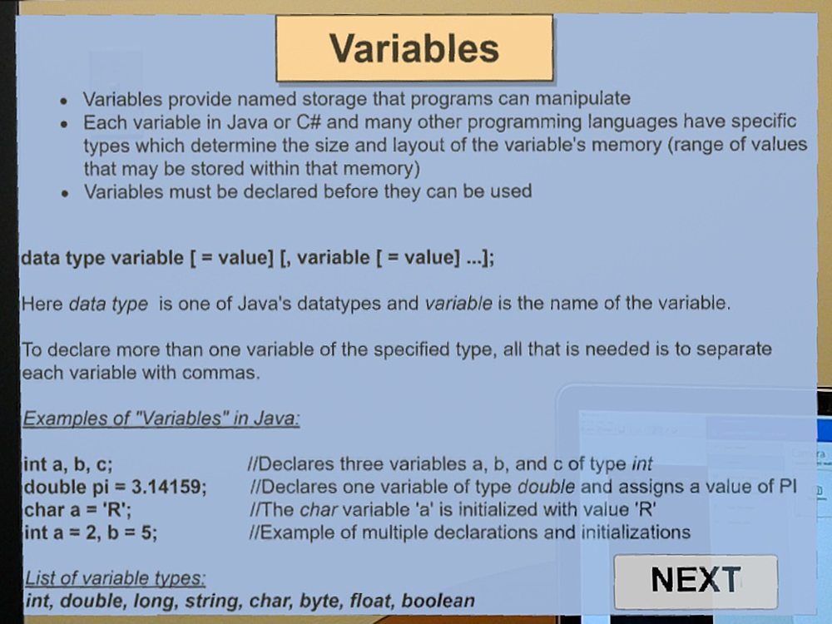
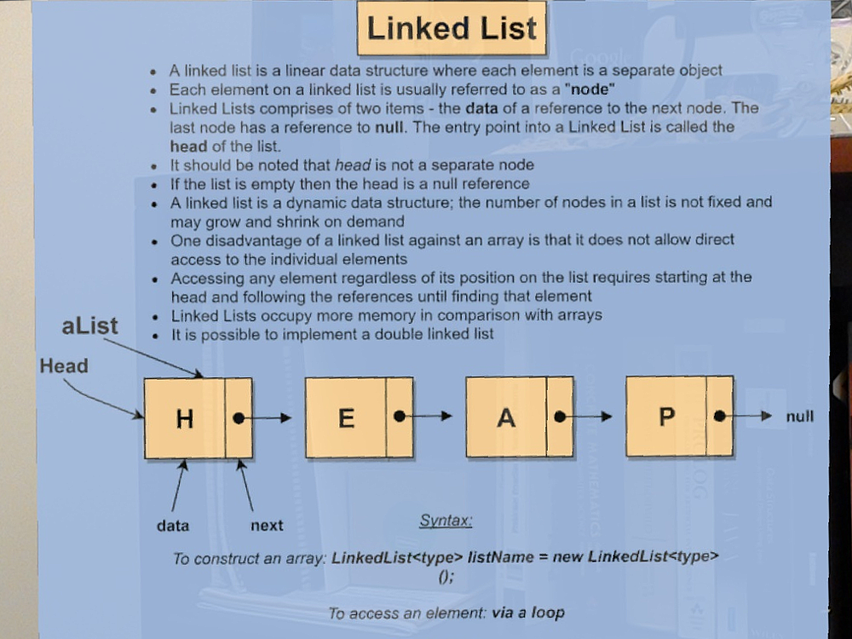
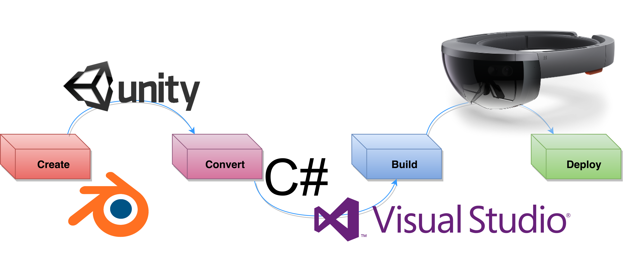
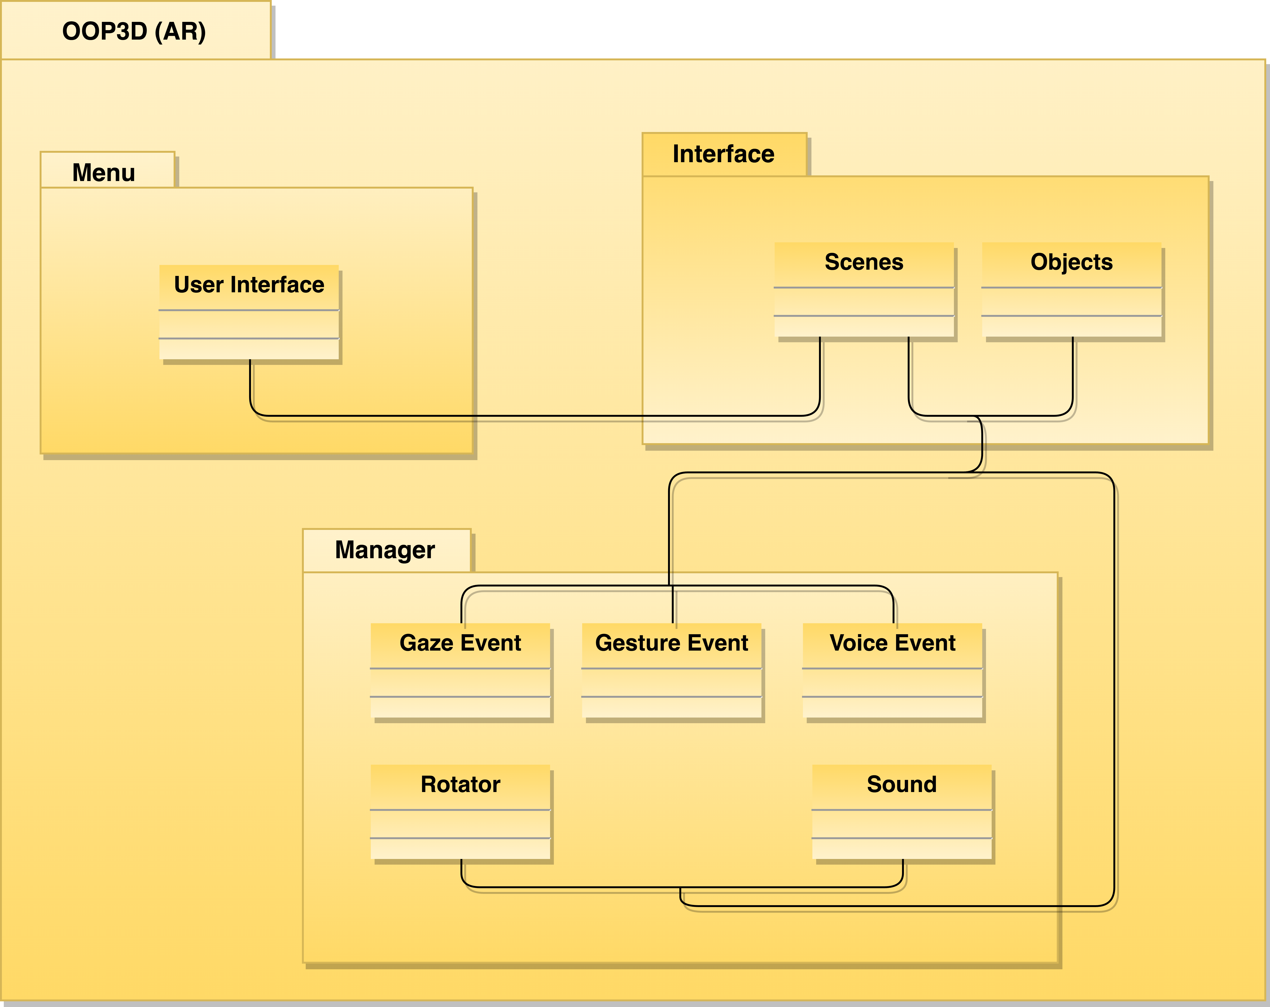
Augmented Reality using OOP Concepts
Senior Project - Spring 2017
Student: Paola Jiron, Florida International University
Mentor: Dr. Francisco Ortega, Florida International University
Mentor: Mohsen Taheri, Florida International University
Instructor: Masoud Sadjadi, Florida International University
School of Computing
& Information Sciences
Purpose
Requirements
This system aims to enable a different venue of teaching and learning by using a 3-Dimensional approach to integrate Object Oriented Programming (OOP) concepts.
Development requires four steps:
Creating the project (objects and functionality)
Conversion from static to interactive scenery
Building and compilation
Deploying to the Hololens device
Integration of a standalone 3-Dimensional application involves the interaction between device and user via three aspects:
Gaze Recognition
Gesture Recognition
Voice Recognition
Application
Integrating AR in the field of programming, opens a broad spectrum of uses. Hence, generating opportunities for visual and hands on learning without stripping the student and instructor of a learning environment by adding:
Navigation application using GPS
Sightseeing by exerting a live view of objects
Producing better programmers by engaging in interactive game development
Generating a realistic and immersive education
Game Engine Images
Live Images
Integration
OOP3D is a Microsoft Hololens application which integrates concepts from Object Oriented Programming using 3-Dimensional real life examples. Thus, encouraging students to access their long term cognitive learning potential through Creating, Evaluating, Analyzing, Applying, Understanding, and Recalling information. Ergo, re-enforcing the use of the three learning domains.
Implementation
Acknowledgments
It should be noted that the material presented on this poster is made possible by the research supported by Dr. Francisco Ortega. Nonetheless, I am grateful to the help and support received from the following students and friends: Santiago Bolivar, Alban Delamarre, and Guido Ruiz.
Notes:
1

